Slide 1
The String class
The String class is defined in the java.lang package.
It has some special features that need a little care.
In particular, comparison of String objects can be tricky.

Slide 2
Side note: String equality
tests identity
if(input == "bye") {
...
}
if(input.equals("bye")) {
...
}
Always use .equals for text equality.
tests equality
Notes:
if desired, include more detailed discussion of identity vs equality here.
(That's the next 5 slides, up to "Identity vs equality (Strings)". Skip these if this
is not needed now.

Slide 3
Identity vs equality 1
Other (non-String) objects:
:Person
:Person
“Fred”
“Jill”
person1
person2
person1 == person2 ?
Notes:
== is not true here (of course)

Slide 4
Identity vs equality 2
Other (non-String) objects:
:Person
:Person
“Fred”
“Fred”
person1
person2
person1 == person2 ?
Notes:
== is still not true here (different objects, == tests identity)

Slide 5
Identity vs equality 3
Other (non-String) objects:
:Person
:Person
“Fred”
“Fred”
person1
person2
person1 == person2 ?
Notes:
== is true now (same object)

Slide 6
Identity vs equality (Strings)
String input = reader.getInput();
if(input == "bye") {
...
}
== tests identity
:String
:String
==
?
"bye"
"bye"
input
à (may be) false!
Notes:
== is still not true here (different objects, == tests identity)

Slide 7
Identity vs equality (Strings)
String input = reader.getInput();
if(input.equals("bye")) {
...
}
equals tests equality
:String
:String
equals
?
"bye"
"bye"
input
à true!
Notes:
== is still not true here (different objects, == tests identity)

Slide 8
The problem with Strings
The compiler merges identical String literals in the program code.
The result is reference equality for apparently distinct String objects.
But this cannot be done for identical strings that arise outside the program’s code;
e.g., from user input.

Slide 9
Moving away from String
Our collection of String objects for music tracks is limited.
No separate identification of artist, title, etc.
A Track class with separate fields:
artist
title
filename

Slide 10
Grouping objects
Iterators
Notes:
also explain: how to pass an ArrayList for testing

Slide 11
Iterator and iterator()
Collections have an iterator() method.
This returns an Iterator object.
Iterator<E> has three methods:
boolean hasNext()
E next()
void remove()

Slide 12
Using an Iterator object
java.util.Iterator
returns an Iterator object
Iterator<ElementType> it = myCollection.iterator();
while(it.hasNext()) {
call it.next() to get the next object
do something with that object
}
public void listAllFiles()
{
Iterator<Track> it = files.iterator();
while(it.hasNext()) { Track tk = it.next();
System.out.println(tk.getDetails());
}
}

Slide 13
Iterator mechanics

Slide 14
myList:List
myList.iterator()
:Element
:Element
:Element
:Element
:Iterator

Slide 15
myList:List
:Element
:Element
:Element
:Element
:Iterator
:Iterator
hasNext()?
✔
next()
Element e = iterator.next();

Slide 16
myList:List
:Element
:Element
:Element
:Element
:Iterator
:Iterator
hasNext()?
✔
next()

Slide 17
myList:List
:Element
:Element
:Element
:Element
:Iterator
:Iterator
hasNext()?
✔
next()

Slide 18
myList:List
:Element
:Element
:Element
:Element
:Iterator
:Iterator
hasNext()?
✔
next()

Slide 19
myList:List
:Element
:Element
:Element
:Element
:Iterator
✗
hasNext()?

Slide 20
Index versus Iterator
Ways to iterate over a collection:
for-each loop.
Use if we want to process every element.
while loop.
Use if we might want to stop part way through.
Use for repetition that doesn't involve a collection.
Iterator object.
Use if we might want to stop part way through.
Often used with collections where indexed access is not very efficient, or impossible.
Use to remove from a collection.
Iteration is an important programming pattern.

Slide 21
Removing from a collection
Iterator<Track> it = tracks.iterator();
while(it.hasNext()) {
Track t = it.next();
String artist = t.getArtist();
if(artist.equals(artistToRemove)) {
it.remove();
}
}
Use the Iterator’s remove method.

Slide 22
Review
Loop statements allow a block of statements to be repeated.
The for-each loop allows iteration over a whole collection.
The while loop allows the repetition to be controlled by a boolean expression.
All collection classes provide special Iterator objects that provide sequential access to a whole collection.

Slide 23
The auction project
The auction project provides further illustration of collections and iteration.
Examples of using null.
Anonymous objects.
Chaining method calls.

Slide 24
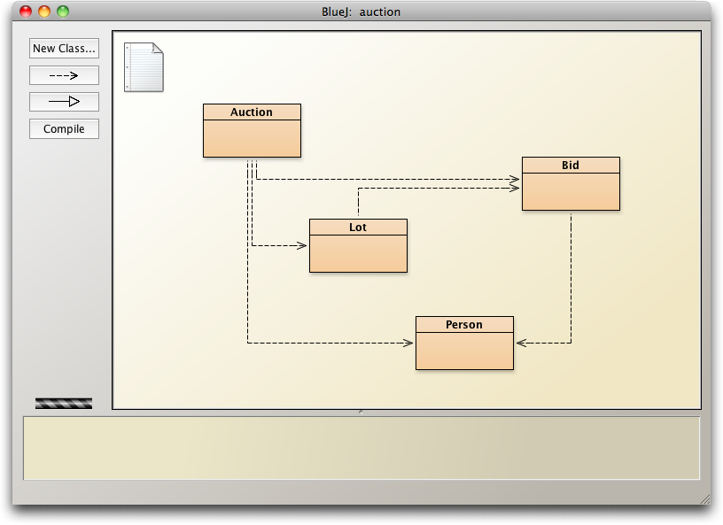
The auction project

Slide 25
null
Used with object types.
Used to indicate, 'no object'.
We can test if an object variable holds the null value: if(highestBid == null) …
Used to indicate ‘no bid yet’.

Slide 26
Anonymous objects
Objects are often created and handed on elsewhere immediately: Lot furtherLot = new Lot(…); lots.add(furtherLot);
We don’t really need furtherLot: lots.add(new Lot(…));

Slide 27
Chaining method calls
Methods often return objects.
We often immediately call a method on the returned object. Bid bid = lot.getHighestBid(); Person bidder = bid.getBidder();
We can use the anonymous object concept and chain method calls: lot.getHighestBid().getBidder()

Slide 28
Chaining method calls
Each method in the chain is called on the object returned from the previous method call in the chain.
String name = lot.getHighestBid().getBidder().getName();
Returns a Bid object from the Lot
Returns a Person object from the Bid
Returns a String object from the Person

Slide 29
Grouping objects
Arrays

Slide 30
Fixed-size collections
Sometimes the maximum collection size can be pre-determined.
A special fixed-size collection type is available: an array.
Unlike the flexible List collections, arrays can store object references or primitive-type values.
Arrays use a special syntax.

Slide 31
The weblog-analyzer project
Web server records details of each access.
Supports analysis tasks:
Most popular pages.
Busiest periods.
How much data is being delivered.
Broken references.
Analyze accesses by hour.

Slide 32
Creating an array object
public class LogAnalyzer
{
private int[] hourCounts;
private LogfileReader reader;
public LogAnalyzer()
{
hourCounts = new int[24];
reader = new LogfileReader();
}
...
}
Array variable declaration — does not contain size
Array object creation — specifies size

Slide 33
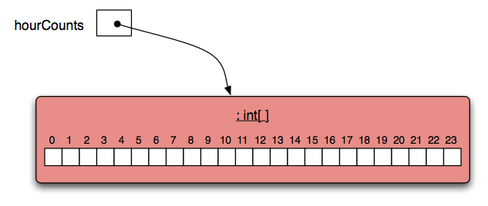
The hourCounts array

Slide 34
Using an array
Square-bracket notation is used to access an array element: hourCounts[...]
Elements are used like ordinary variables.
The target of an assignment:
hourCounts[hour] = ...;
In an expression:
hourCounts[hour]++;
adjusted = hourCounts[hour] – 3;

Slide 35
Standard array use
private int[] hourCounts;
private String[] names;
...
hourCounts = new int[24];
...
hourcounts[i] = 0;
hourcounts[i]++;
System.out.println(hourcounts[i]);
declaration
creation
use

Slide 36
Array literals
The size is inferred from the data.
private int[] numbers = { 3, 15, 4, 5 };
declaration, creation and initialization
Array literals in this form can only be used in declarations.
Related uses require new:
numbers = new int[] { 3, 15, 4, 5 };

Slide 37
Array length
private int[] numbers = { 3, 15, 4, 5 };
int n = numbers.length;
no brackets!
NB: length is a field rather than a method!
It cannot be changed – ‘fixed size’.

Slide 38
The for loop
There are two variations of the for loop, for-each and for.
The for loop is often used to iterate a fixed number of times.
Often used with a variable that changes a fixed amount on each iteration.

Slide 39
For loop pseudo-code
General form of the for loop
for(initialization; condition; post-body action) {
statements to be repeated
}
Equivalent in while-loop form
initialization;
while(condition) {
statements to be repeated
post-body action
}

Slide 40
A Java example
for loop version
for(int hour = 0; hour < hourCounts.length; hour++) {
System.out.println(hour + ": " + hourCounts[hour]);
}
while loop version
int hour = 0;
while(hour < hourCounts.length) {
System.out.println(hour + ": " + hourCounts[hour]);
hour++;
}

Slide 41
Practice
Given an array of numbers, print out all the numbers in the array, using a for loop.
int[] numbers = { 4, 1, 22, 9, 14, 3, 9};
for ...

Slide 42
Practice
Fill an array with the Fibonacci sequence.
0 1 1 2 3 5 8 13 21 34 ...
int[] fib = new int[100];
fib[0] = 0;
fib[1] = 1;
for ...

Slide 43
for loop with bigger step
// Print multiples of 3 that are below 40.
for(int num = 3; num < 40; num = num + 3) {
System.out.println(num);
}

Slide 44
Review
Arrays are appropriate where a fixed-size collection is required.
Arrays use a special syntax.
For loops are used when an index variable is required.
For loops offer an alternative to while loops when the number of repetitions is known.
Used with a regular step size.

